Slide 1
April 11th 2021
South Florida MCS
Harry Weinman (SPC)
Notes:
This was a pretty interesting (and rare) case of an organized back-building MCS that overspread South Florida on April 11 2021.

Slide 2
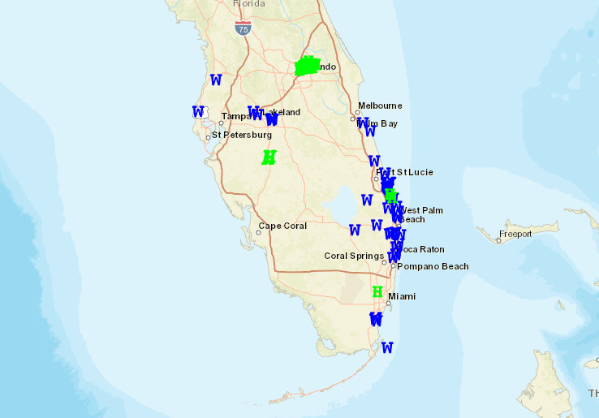

Slide 3
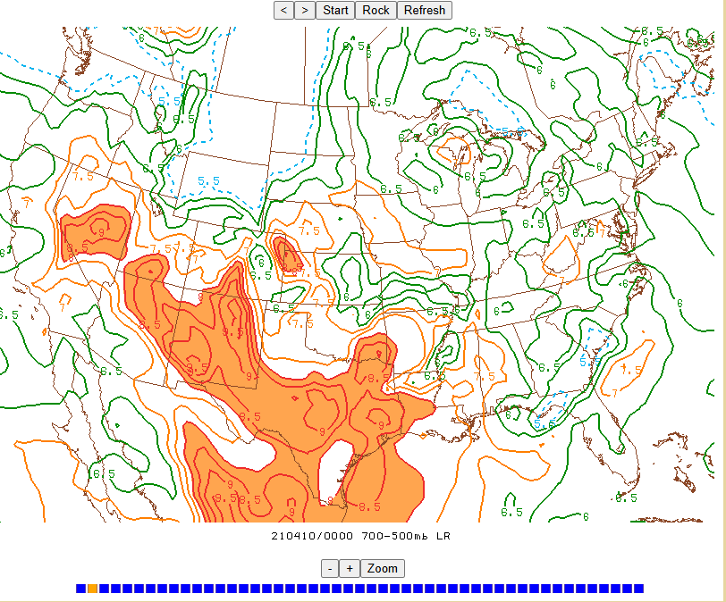
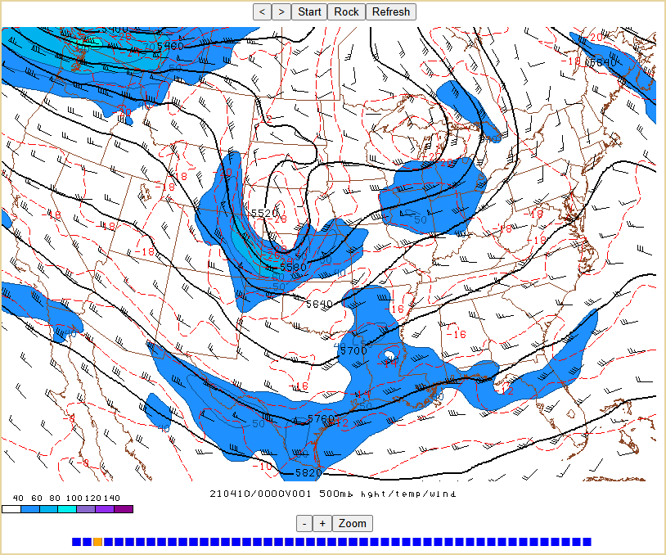

Slide 4
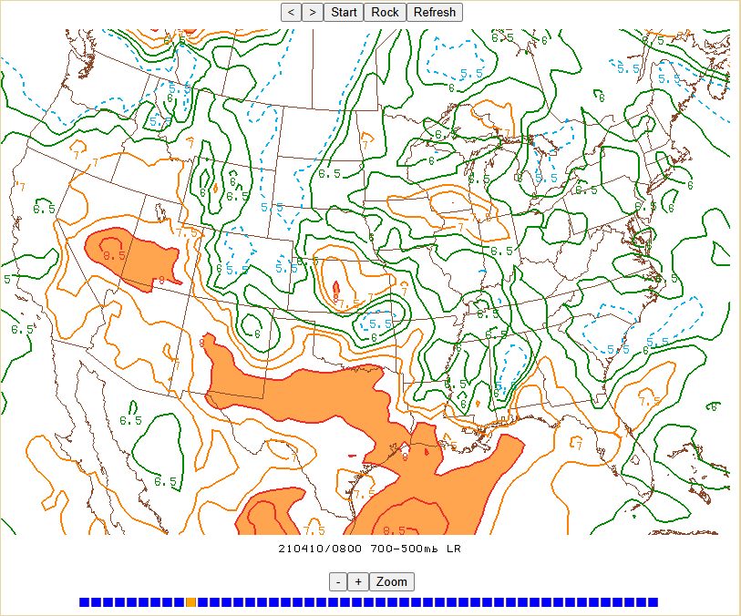
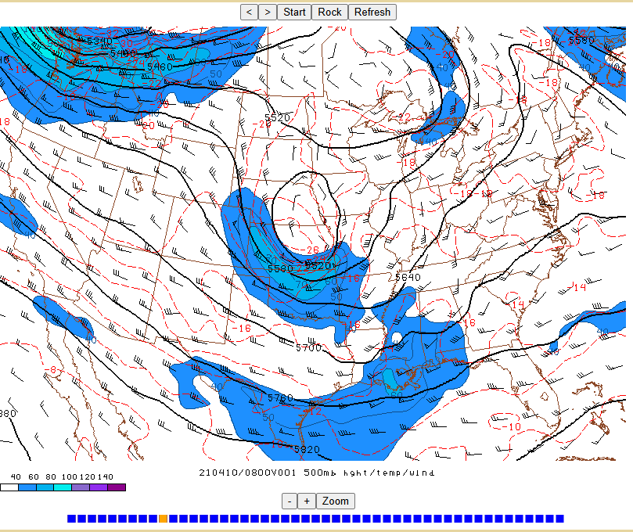

Slide 5
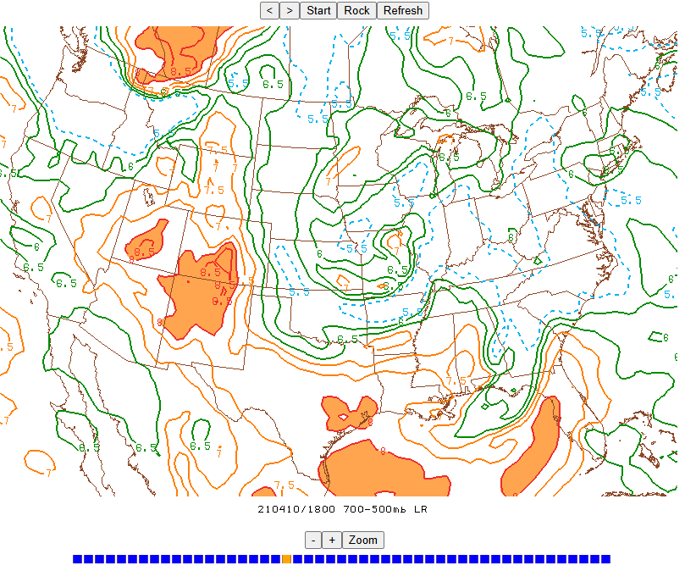
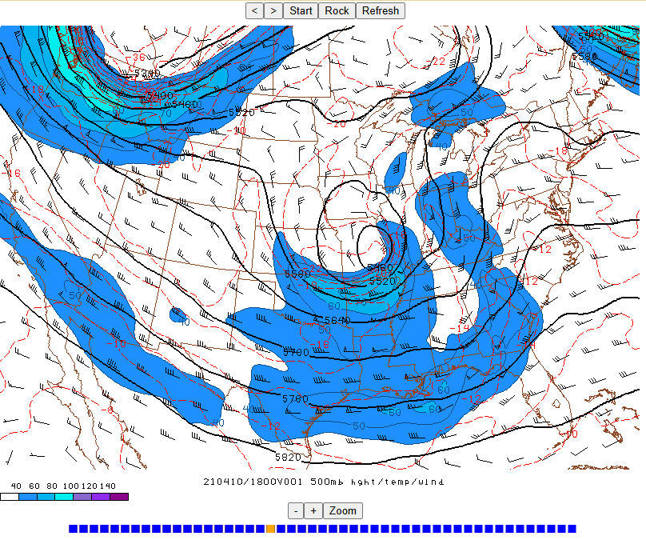

Slide 6
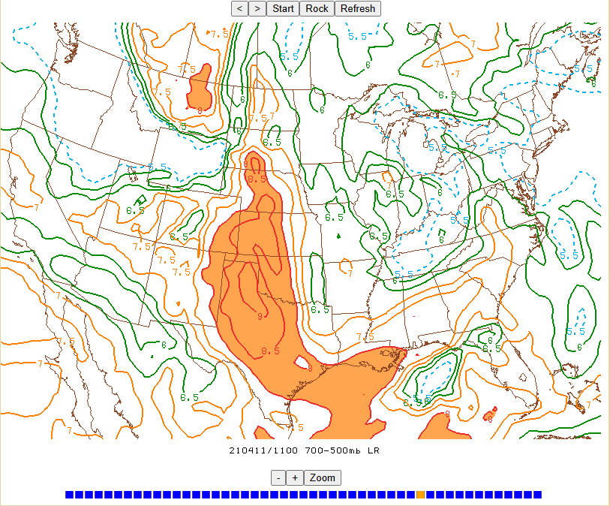
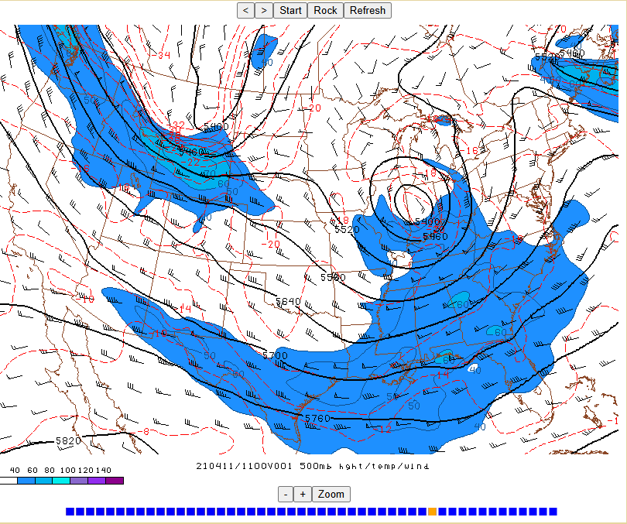
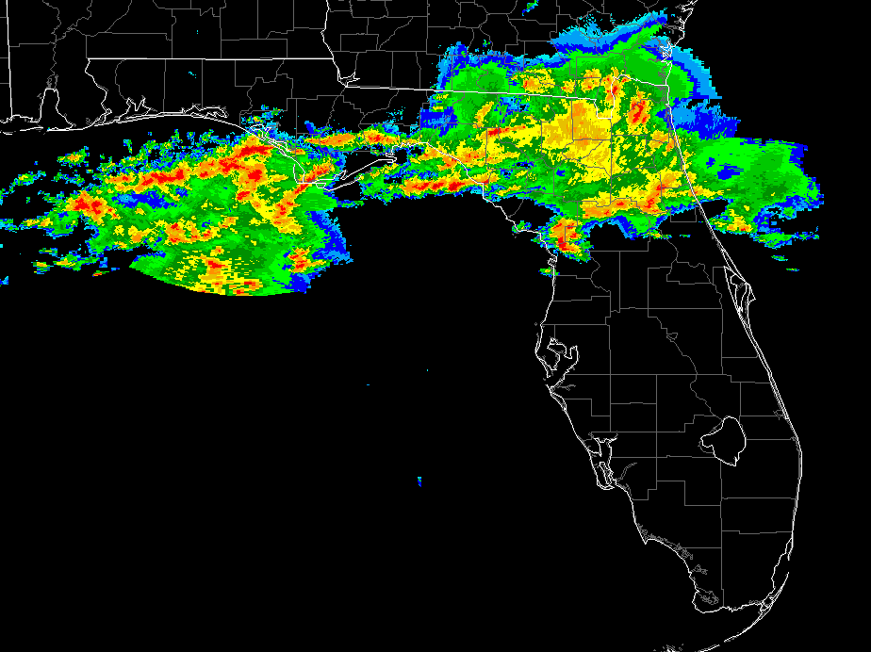

Slide 7
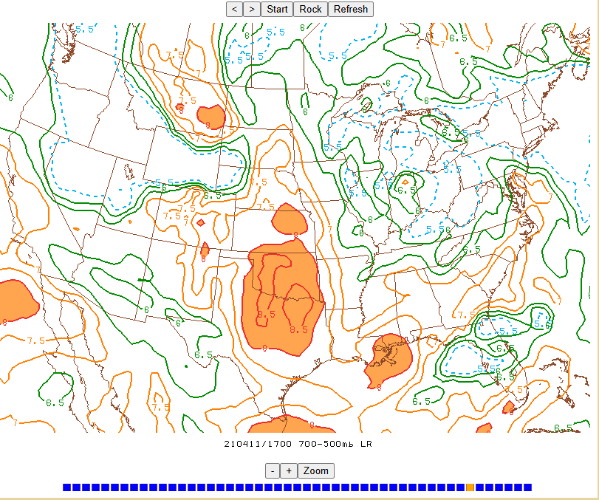
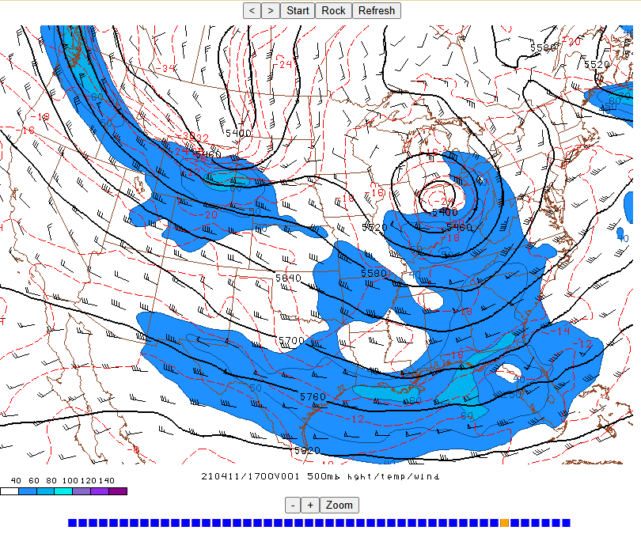
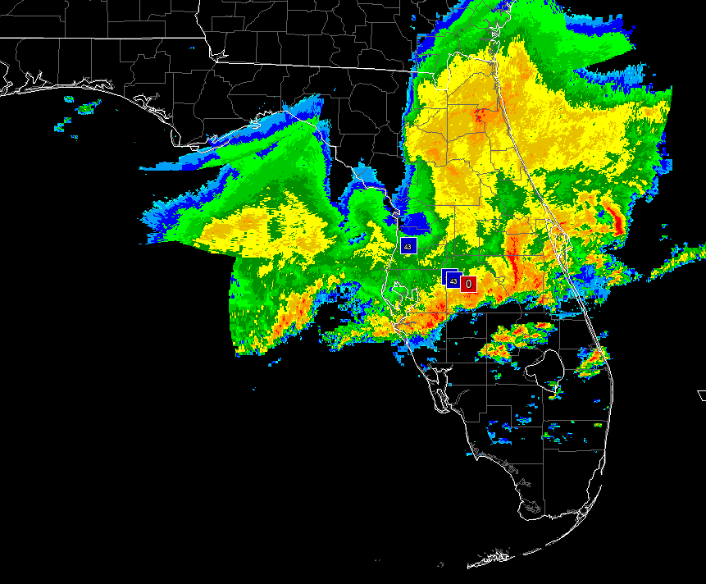
?

Slide 8
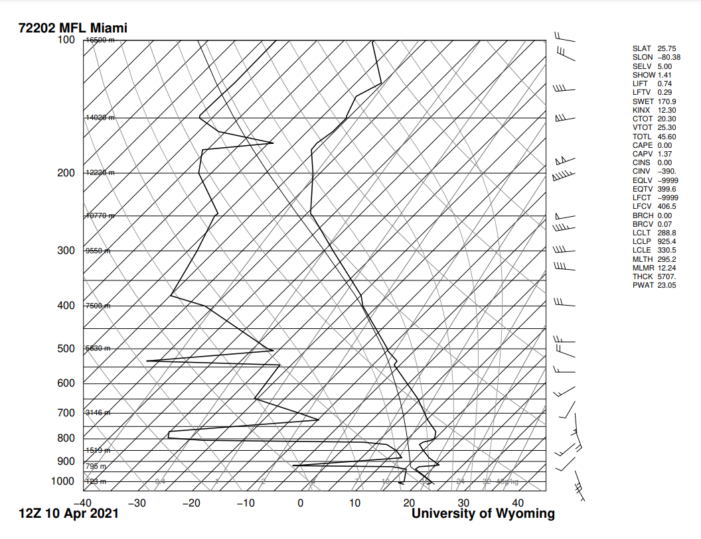

Slide 9
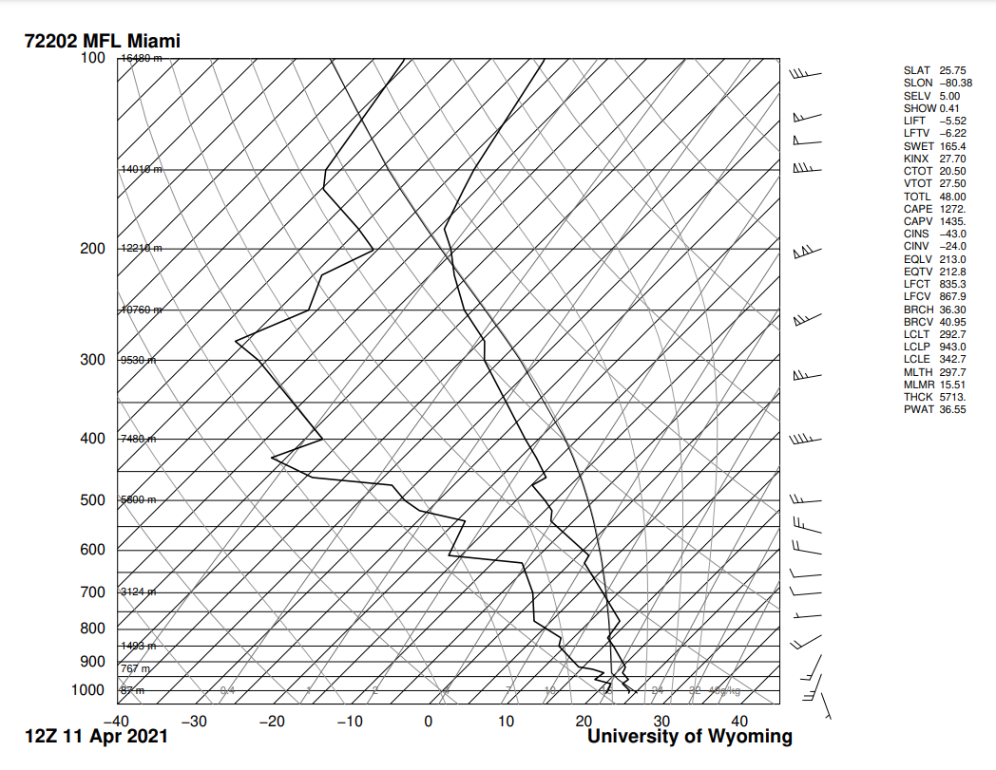

Slide 10
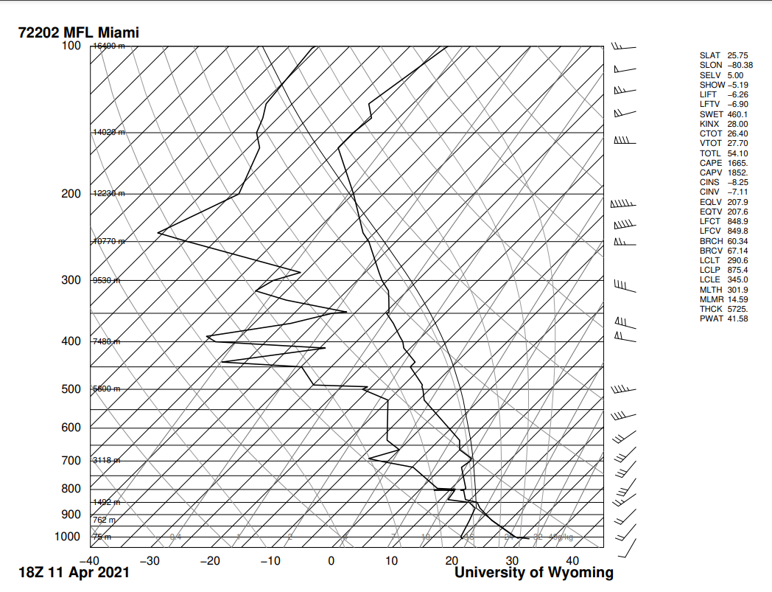

Slide 11
Time | 4/10/12z | 4/11/12z | 4/11/18z
0-1 km lapse rate
700-500 mb lapse rate

Slide 12
Numbers are rounded for simplicity
Time | 4/10/12z | 4/11/12z | 4/11/18z
0-1 km lapse rate | 22-19= 3 C/km | 24-19.5= 4.5 C/km | 31-21= 10 C/km
700-500 mb lapse rate | 8.5-(-10.5)/2.6 km =7.3 C/km | 8-(-11.5)/2.6 km =7.5 C/km | 8.5-(-11.5)/2.6 km = 7.8 C/km

Slide 13
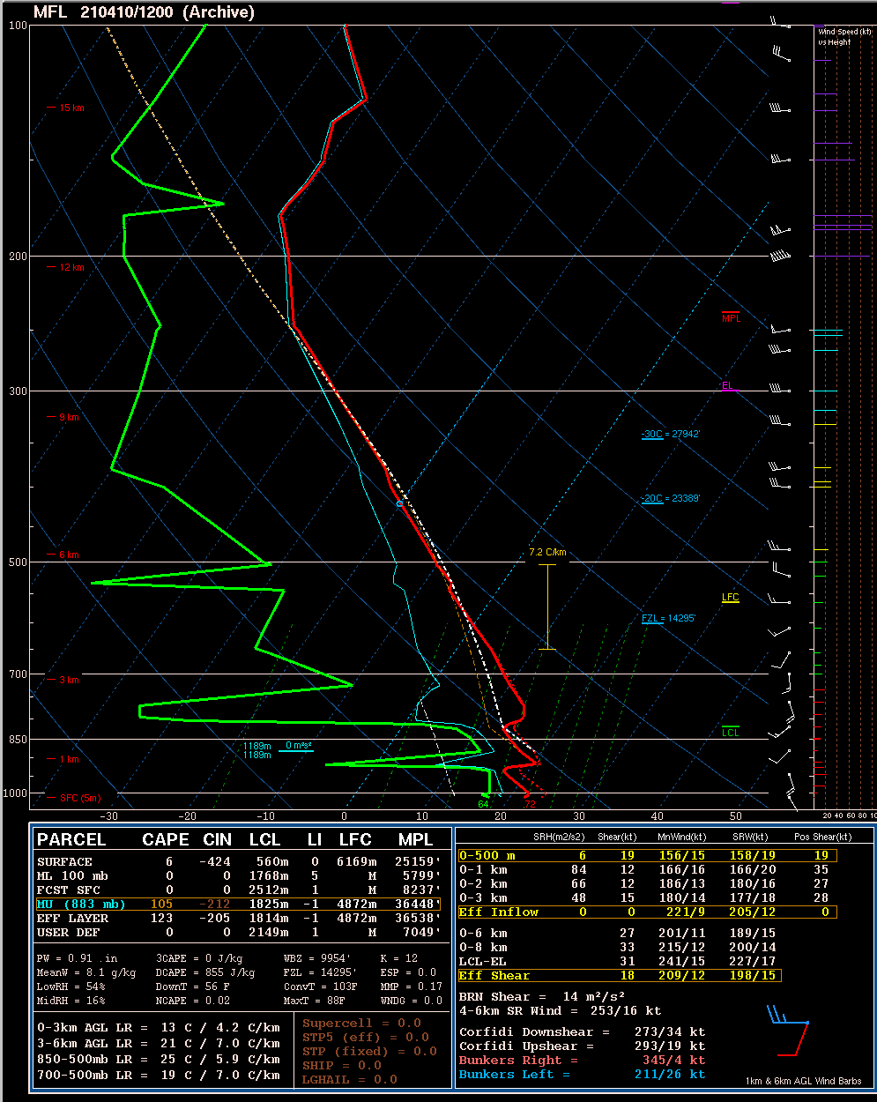
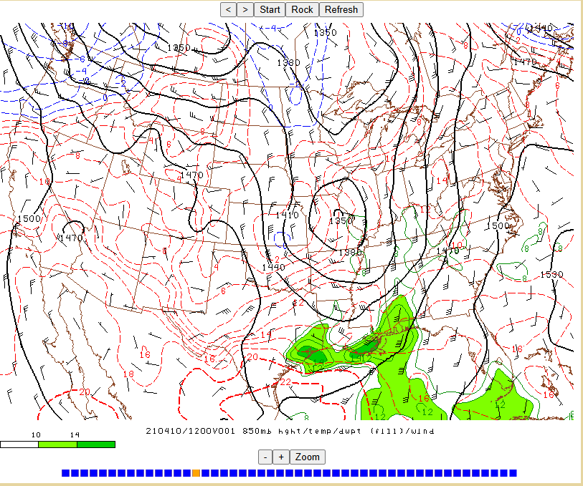
Leading edge of remnant EML plume already in place atop southerly low-level flow across S FL the day prior to event

Slide 14
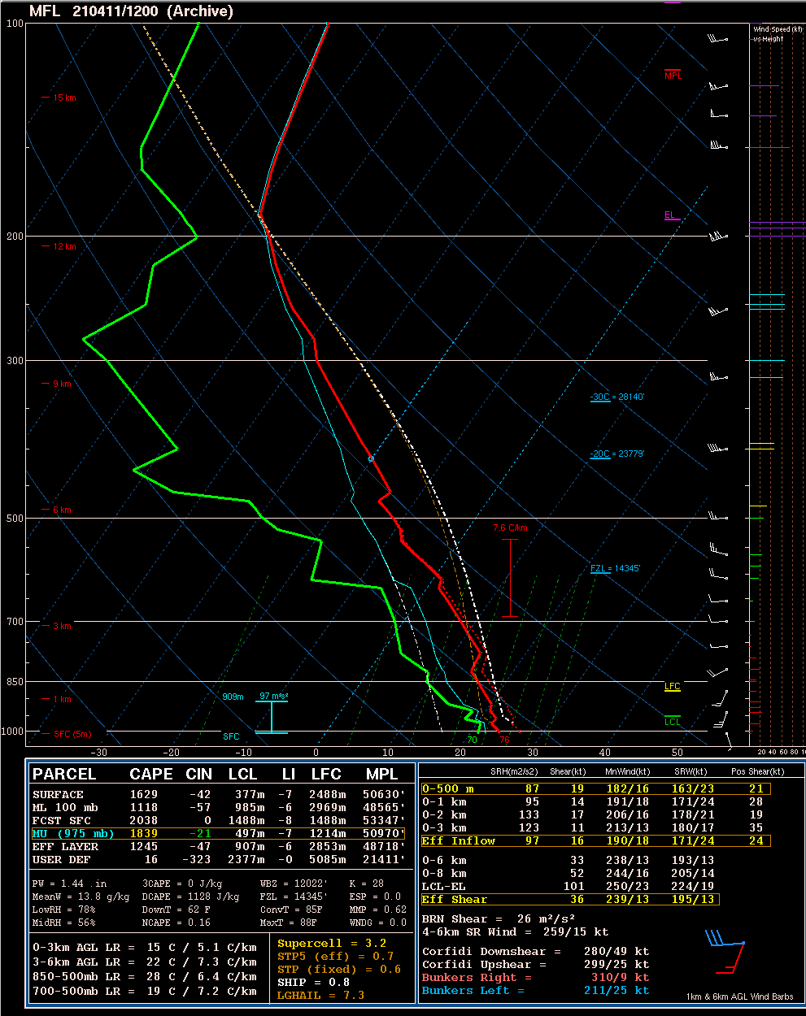
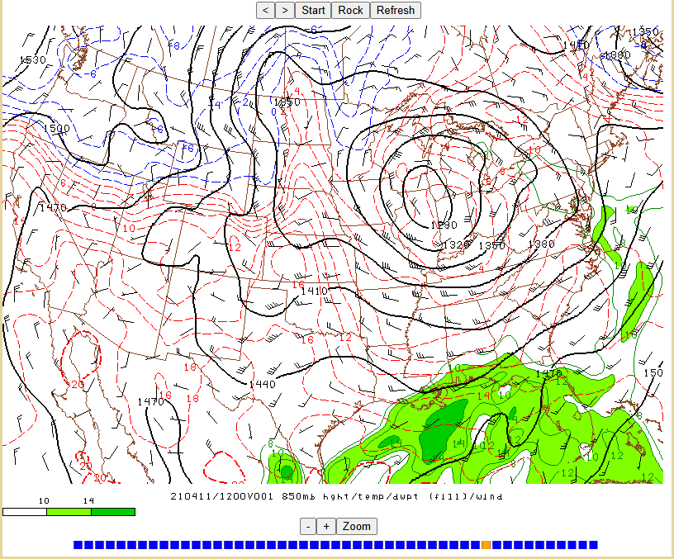
Increasing low-level mass response to approaching subtle/embedded midlevel wave (increasing warm/moist advection) ascent!

Slide 15
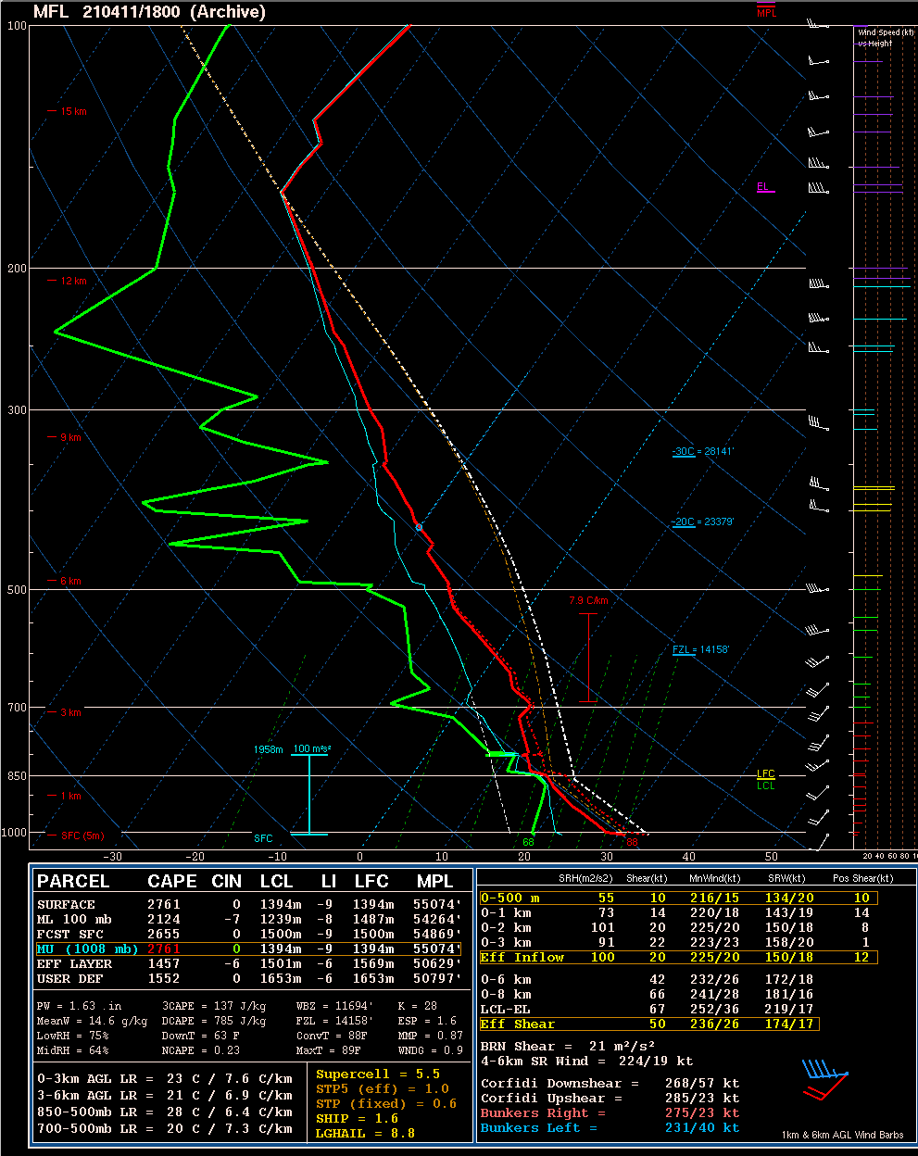
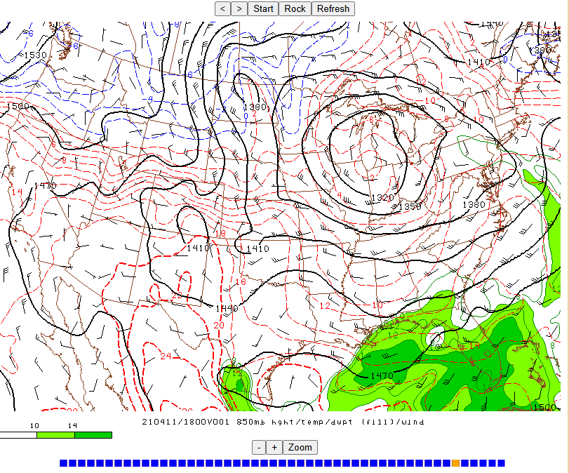
Continued synoptic-scale ascent/low-level moistening, diurnally steepening low-level lapse rates, remnant EML = pretty impressive sounding for S FL!

Slide 16
Note- Favorable deep-layer shear in place for organized storms

Slide 17
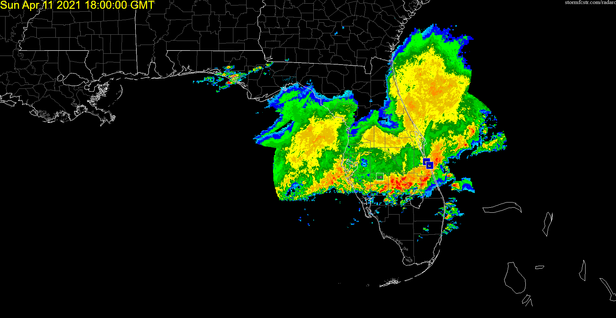

Slide 18
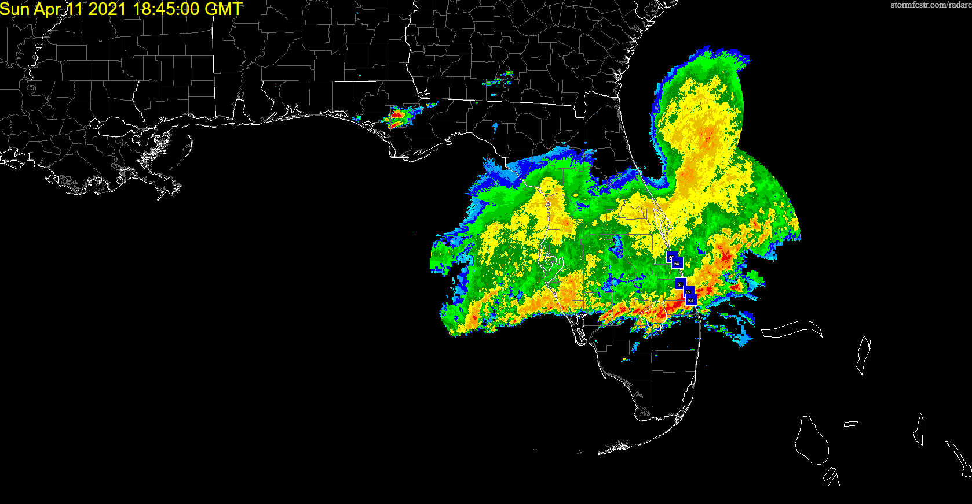

Slide 19
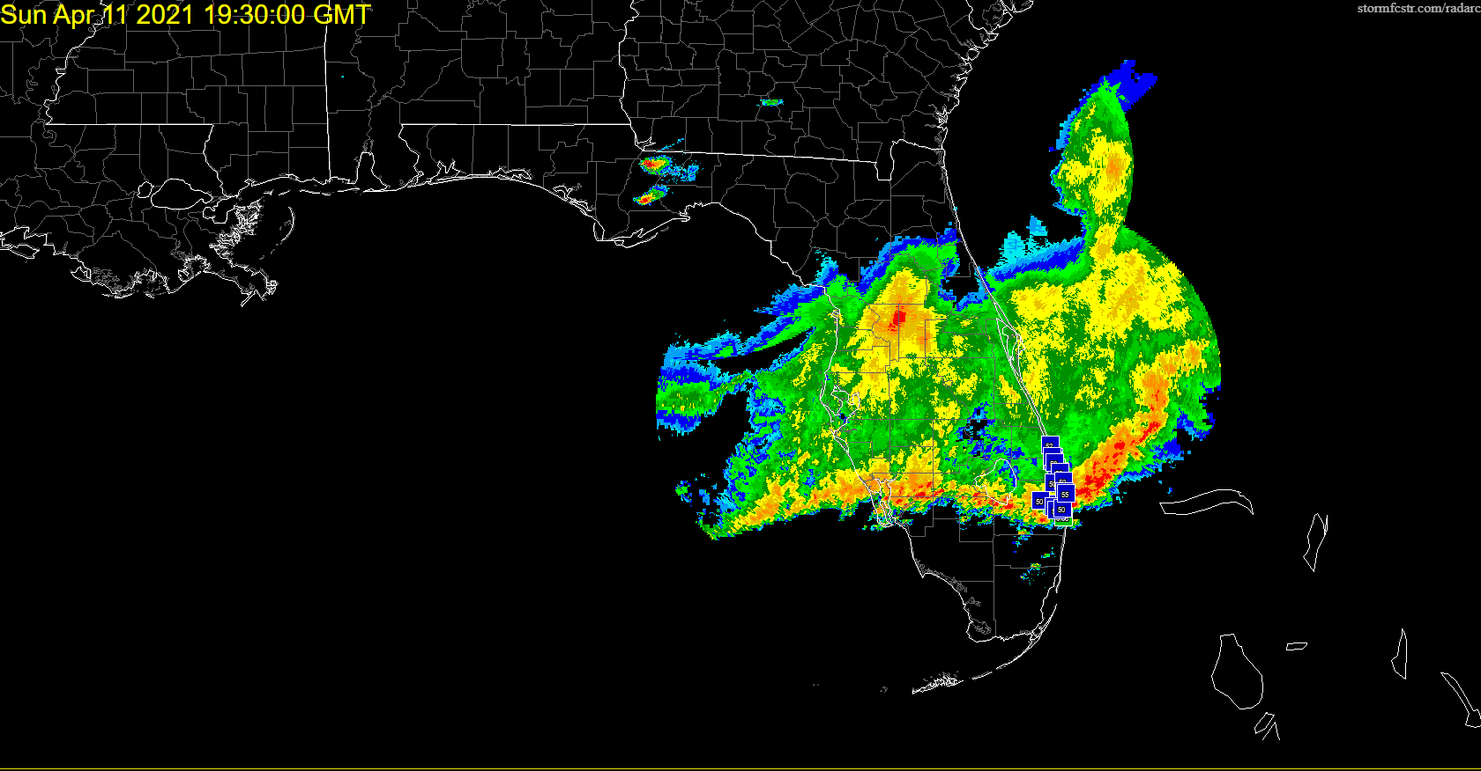

Slide 20
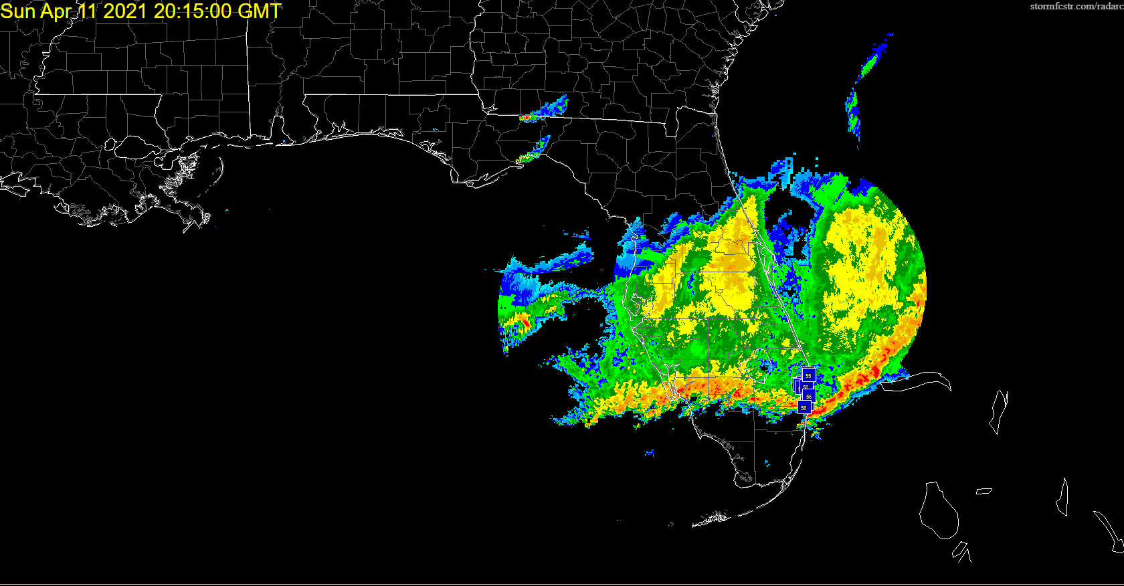

Slide 21
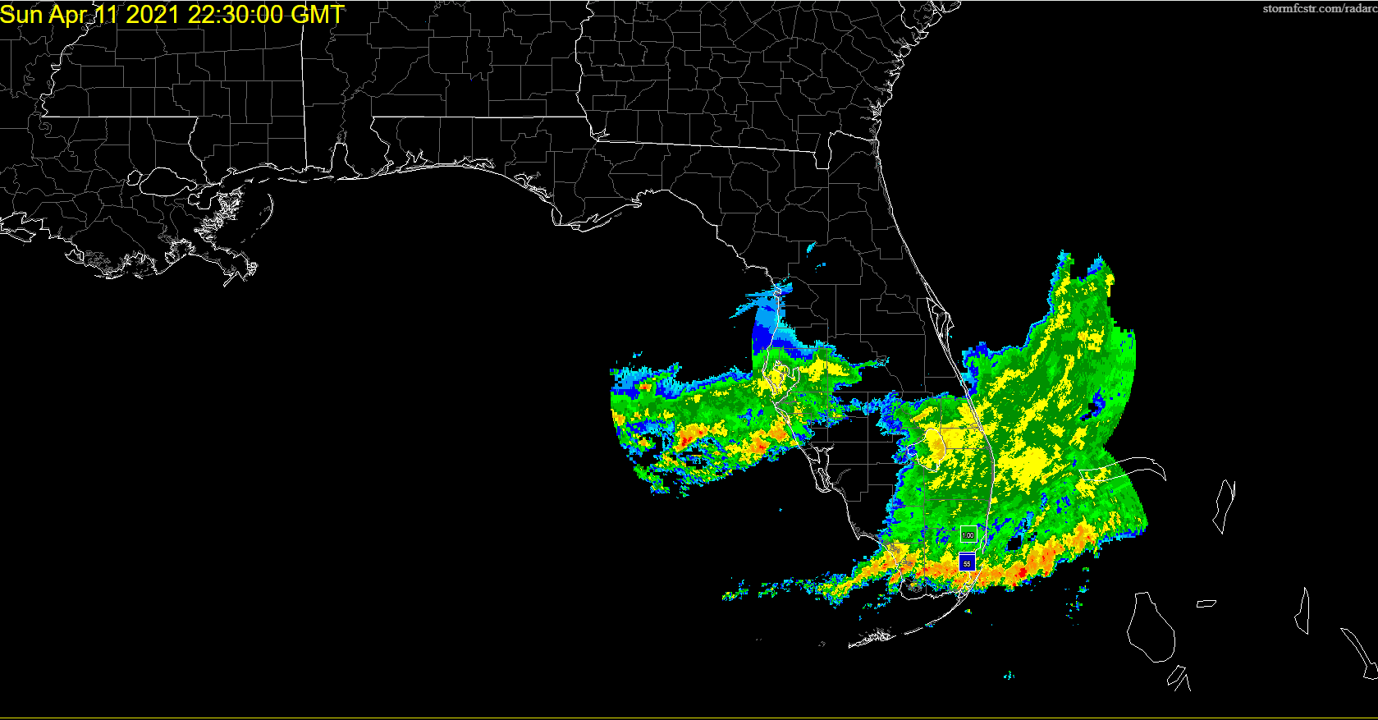

Slide 22
Some Key Takeaways
Substantial changes occurred to the thermodynamic (and kinematic) profile over a short period of time:
– Remnant EML in place, prolonged (albeit modest) synoptic-scale ascent, low-level moistening, and strong diurnal heating all acted to destabilize the profile
– Lack of stronger synoptic and mesoscale ascent over S FL limited convective development ahead of the approaching MCS from the north (maintaining steep midlevel lapse rates, with ample diurnal heating/steepening low-level lapse rates)
–Low-level moisture advection offsets buoyancy losses from vertical mixing

Slide 23
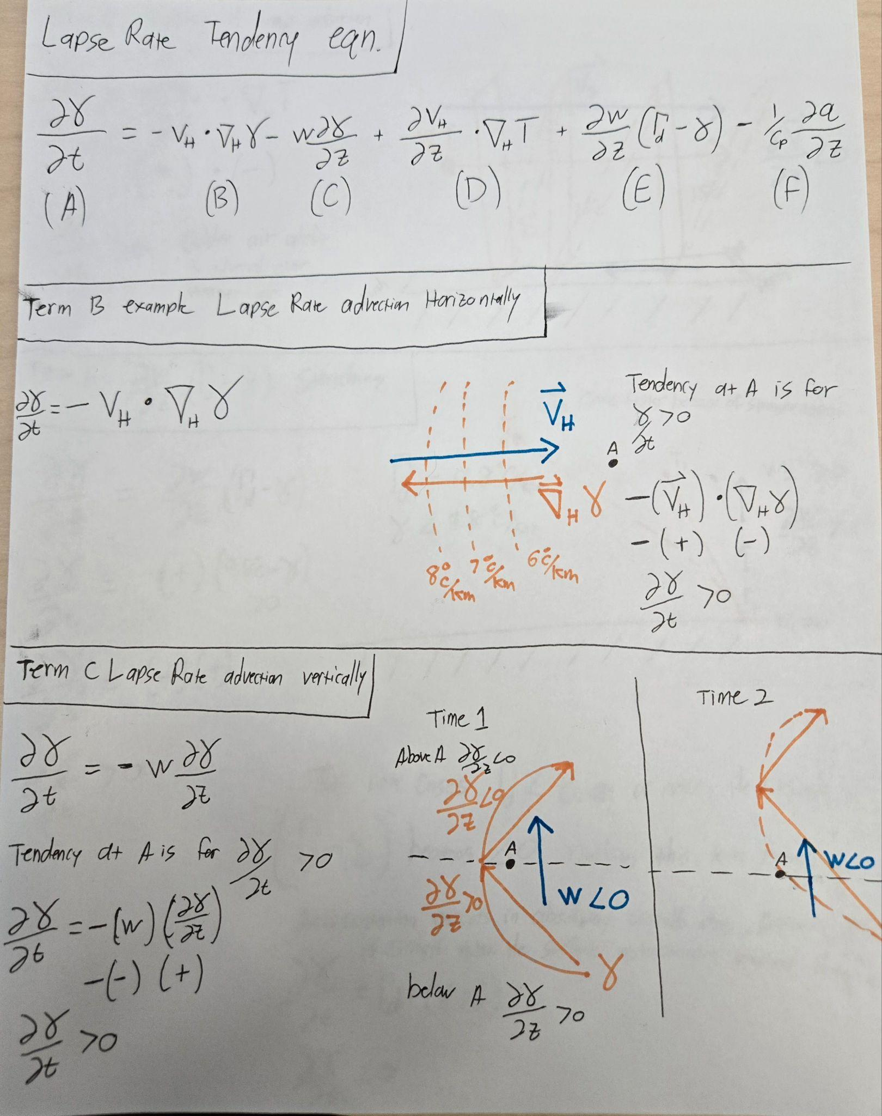

Slide 24
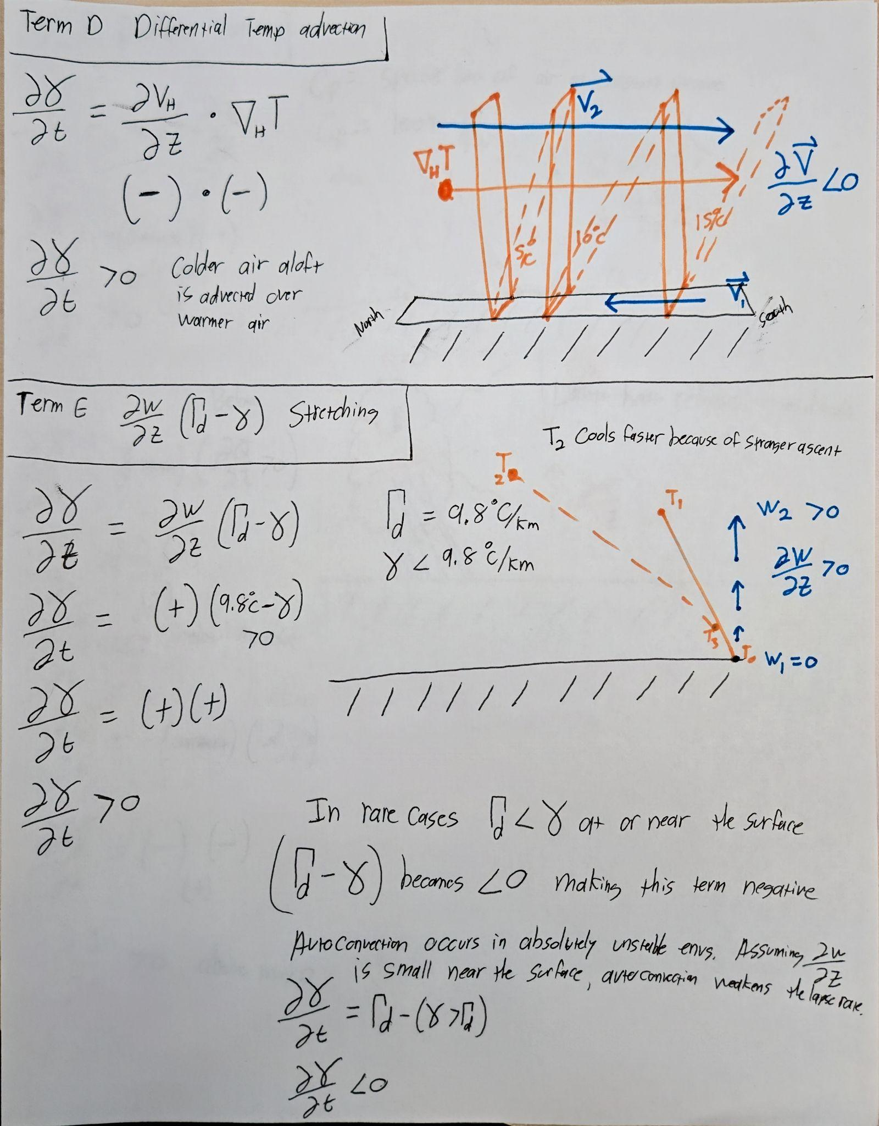

Slide 25
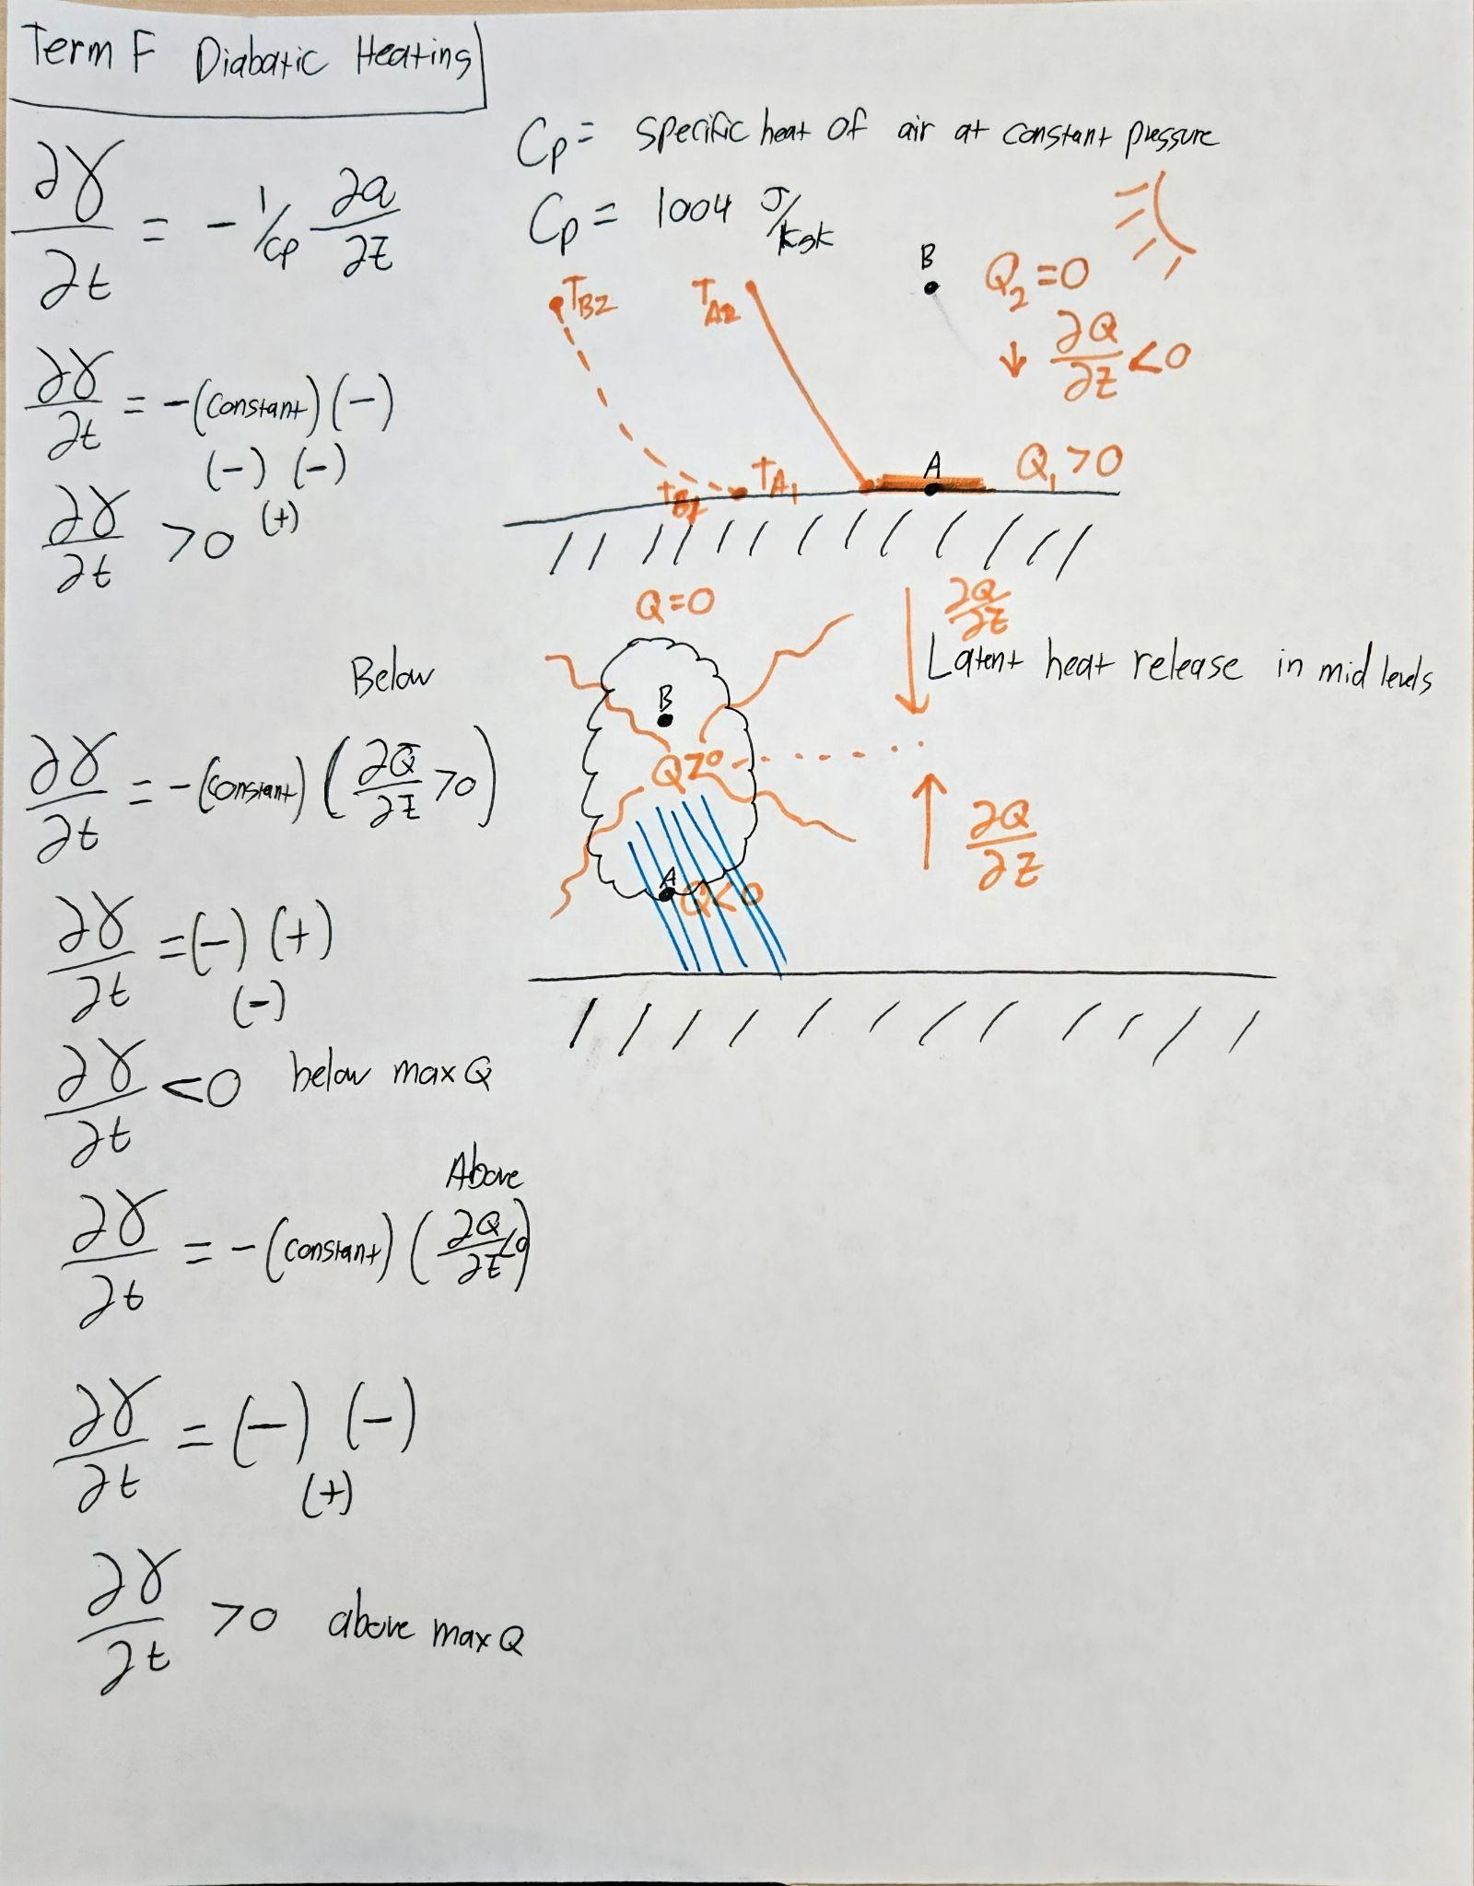

Slide 26
SPC Video Lecture Series
https://www.spc.noaa.gov/exper/spcousom/
Lapse rate tendency derivation:https://www.youtube.com/watch?v=2iNtFJ3neIQ

